Slide 1
Moderation Part 3: continuous variable interactions
Connor McCabe
Psychology 523/525

Slide 2
“One great virtue of good graphical representation is that it can serve to display clearly and effectively a message carried by quantities whose calculation or observation is far from simple.”
- Tukey (1965)

Slide 3
Centering, revisited
In additive models, centering helped facilitate the interpretation of our intercept.
Without an interaction term, no other coefficients will change.
In the categorical case, we center around different categories so that 0 represents a particular category
E.g., when psych=1, 0 means non-psychology faculty

Slide 4
Centering, revisited
In the categorical case, we center around different categories so that 0 represents a particular category
E.g., when psych=1, 0 means non-psychology faculty
 | β | Estimate | SE | 95% CI Lower Bound | 95% CI Upper Bound | t value | Pr(>|t|)
Intercept | 0.00 | 61148.77 | 3915.03 | 53411.32 | 68886.23 | 15.62 | 0.00
Department (1=Psychology) | -0.73 | -25492.84 | 6483.39 | -38306.26 | -12679.41 | -3.93 | 0.00
Publications | 0.15 | 346.94 | 270.19 | -187.05 | 880.93 | 1.28 | 0.20
Department*Publications | 0.03 | 1025.98 | 368.65 | 297.40 | 1754.57 | 2.78 | 0.01
 | β | Estimate | SE | 95% CI Lower Bound | 95% CI Upper Bound | t value | Pr(>|t|)
Intercept | 0.00 | 35655.94 | 5167.87 | 25442.43 | 45869.44 | 6.90 | 0.00
Department (1=Not Psychology) | 0.73 | 25492.84 | 6483.39 | 12679.41 | 38306.26 | 3.93 | 0.00
Publications | 0.60 | 1372.92 | 250.80 | 877.25 | 1868.59 | 5.47 | 0.00
Department*Publications | -0.03 | -1025.98 | 368.65 | -1754.57 | -297.40 | -2.78 | 0.01

Slide 5
This concept can be leveraged to probe a continuous variable interaction effect.
The interpretation of a given coefficient in regression will always be interpreted as the effect when all other predictors are at zero.
We can therefore change the value of zero of our moderator (using centering) to better understand what an interaction means at a level of interest in our continuous moderator.
This is called the pick-a-point approach (Aiken & West, 1991)
Typically, this is conducted at +/- 1 standard deviation from the mean of the moderator.
If I were to re-center around 1 SD below the mean, what transformation would I do to achieve this?

Slide 6
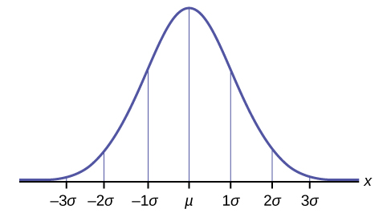
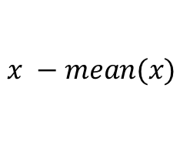
Example
6
2
.2

Slide 7
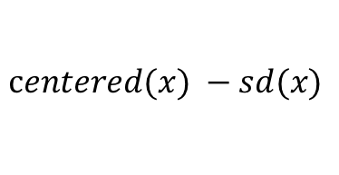
Example

Slide 8

Example

Slide 9

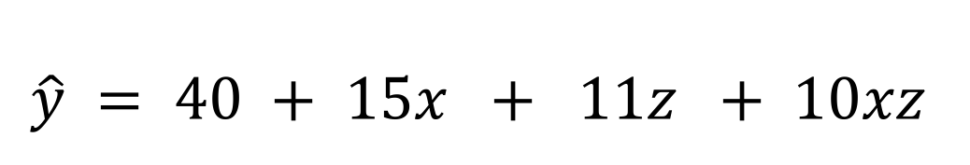
This is no different from computing simple slopes by hand.
$\hat{y} = 40 + 15x + 11z + 10xz$
Rearranging:
$$\hat{y}= 40 + 11z + (15 + 10z)x$$
$$When Z=−1, \hat{y}=29 +5x$$
$$When Z=0, \hat{y}= 40+15x$$
$$When Z=1, \hat{y}=51+25x$$

Slide 10
The benefit with the centering approach in regression is you’ve also conducted simple slopes analysis.
 | β | Estimate | SE | 95% CI Lower Bound | 95% CI Upper Bound | t value | Pr(>|t|)
Intercept | 0 | 35.399 | 4.136 | 27.224 | 43.573 | 8.558 | 0
X | 0.318 | 20.663 | 4.727 | 11.322 | 30.005 | 4.372 | 0
Z | 0.297 | 16.27 | 3.988 | 8.389 | 24.152 | 4.08 | 0
X:Z | 0.263 | 17.113 | 3.668 | 9.863 | 24.362 | 4.665 | 0

Slide 11
The benefit with the centering approach in regression is you’ve also conducted simple slopes analysis.
 | β | Estimate | SE | 95% CI Lower Bound | 95% CI Upper Bound | t value | Pr(>|t|)
 | 0 | 38.15 | 4.109 | 30.029 | 46.271 | 9.284 | 0
center(X) | 0.341 | 22.166 | 4.743 | 12.792 | 31.541 | 4.673 | 0
center(Z) | 0.315 | 17.291 | 4.001 | 9.383 | 25.199 | 4.321 | 0
center(X):center(Z) | 0.263 | 17.113 | 3.668 | 9.863 | 24.362 | 4.665 | 0

Slide 12
The benefit with the centering approach in regression is you’ve also conducted simple slopes analysis.
 | β | Estimate | SE | 95% CI Lower Bound | 95% CI Upper Bound | t value | Pr(>|t|)
 | 0 | 19.803 | 5.994 | 7.958 | 31.648 | 3.304 | 0.001
center(X) | 0.062 | 4.008 | 5.873 | -7.598 | 15.615 | 0.683 | 0.496
probe.low(Z) | 0.315 | 17.291 | 4.001 | 9.383 | 25.199 | 4.321 | 0
center(X):probe.low(Z) | 0.263 | 17.113 | 3.668 | 9.863 | 24.362 | 4.665 | 0

Slide 13
The benefit with the centering approach in regression is you’ve also conducted simple slopes analysis.
 | β | Estimate | SE | 95% CI Lower Bound | 95% CI Upper Bound | t value | Pr(>|t|)
 | 0 | 56.497 | 5.822 | 44.991 | 68.004 | 9.704 | 0
center(X) | 0.62 | 40.324 | 6.388 | 27.699 | 52.95 | 6.312 | 0
probe.high(Z) | 0.315 | 17.291 | 4.001 | 9.383 | 25.199 | 4.321 | 0
center(X):probe.high(Z) | 0.263 | 17.113 | 3.668 | 9.863 | 24.362 | 4.665 | 0

Slide 14
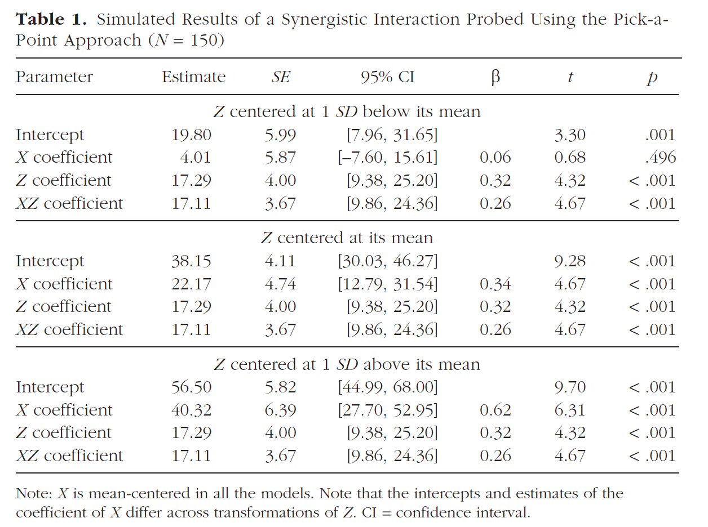
Note this is effectively Table 1 in McCabe (2018)

Slide 15
Taken together, which of these graphs shows my effect?
Option A

Slide 16
Taken together, which of these graphs shows my effect?
Option B

Slide 17
Taken together, which of these graphs shows my effect?
Option C

Slide 18
Taken together, which of these graphs shows my effect?
Option D

Slide 19
What is missing from these analyses and displays?
Notes:
Plots are useful and intuitive, but these plots have problems.
So today we’ll be discussing the question: what elements ARE missing from these graphics? How can we do better?

Slide 20
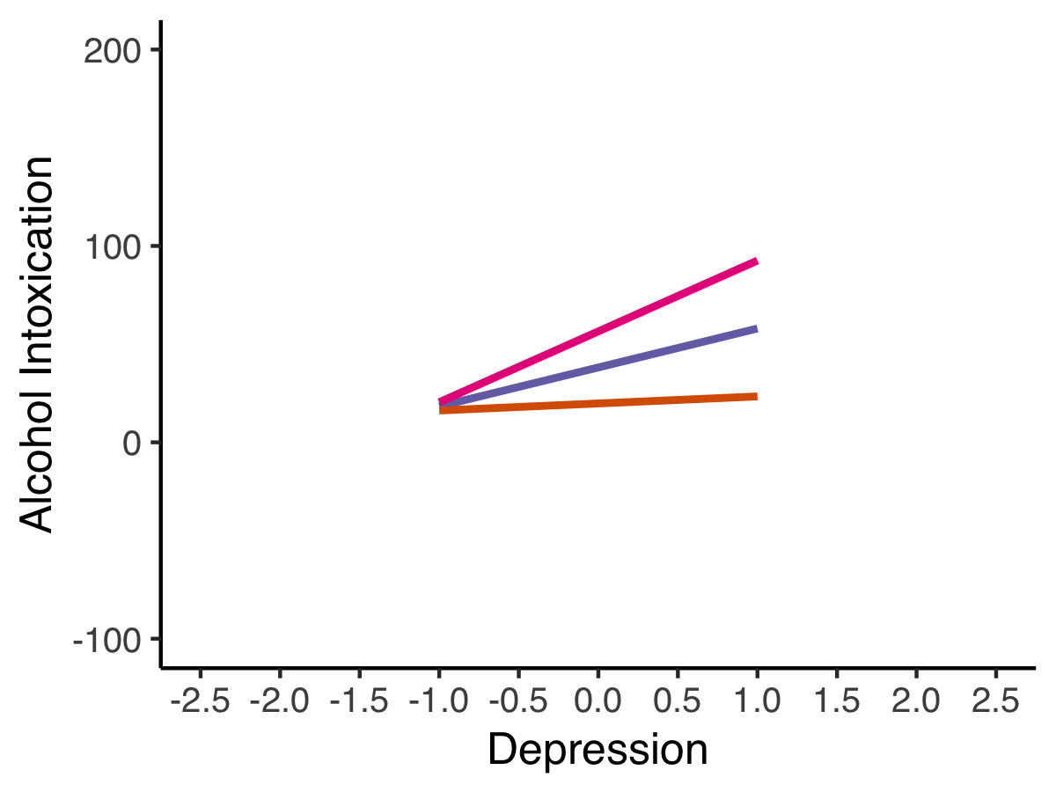
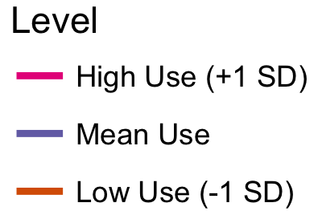
Show the interaction across the full range of the x-axis variable.
*simulated data
Notes:
-Plots often display a limited range of both the predictor and moderator variable
-If only within 1 SD of the x-axis variable, we may miss effects that exist beyond this range.
-Simulated example
-(CLICK) higher on depression is associated with more intoxication when use is high, and this is true across all shown levels depression.

Slide 21
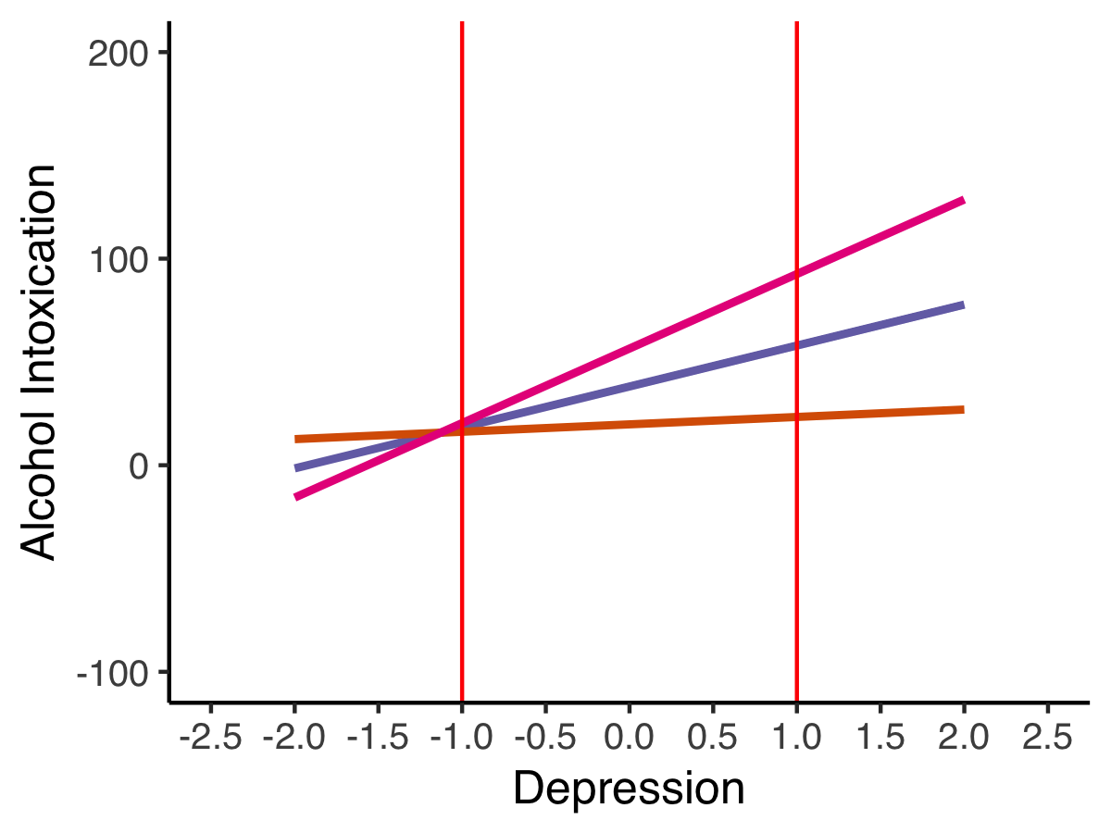
Show the interaction across the full range of the x-axis variable.
*simulated data
Roisman et al, 2012
Notes:
If plotting full range, we may see crossover interaction
E.g., pink line, we might find that individuals who are less than -1 SD below the mean on depression actually report fewer alcohol problems, shown circled in red HERE.
BUT, data needed here

Slide 22
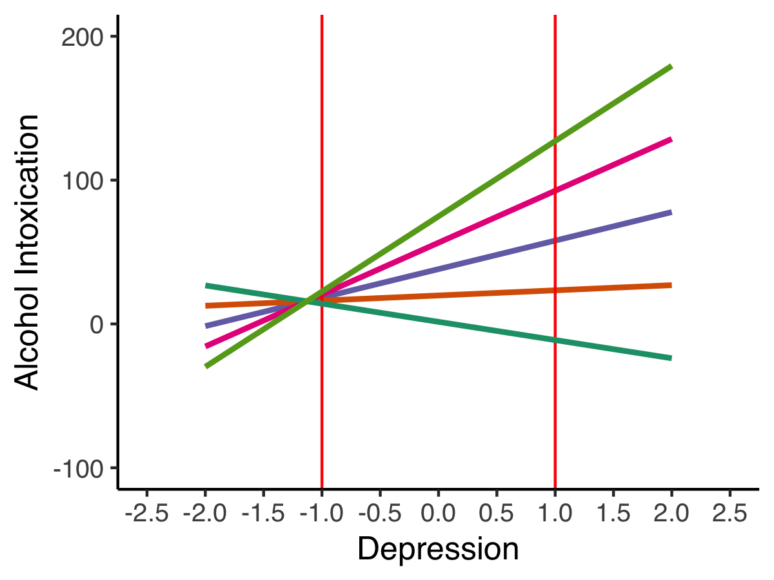
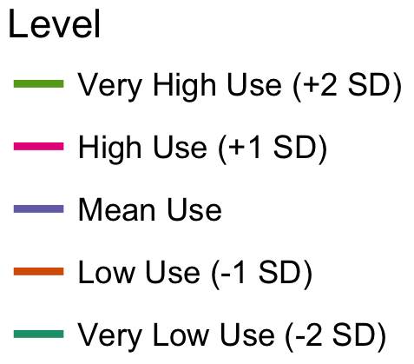
Probe the interaction across the observed range of the moderator.
Notes:
Same for the moderator.
For instance, if only low and high, we might miss negative effect at very low levels of use
Johnson-Neyman regions of significance approach = probing at all levels, but simple slope plots don’t accommodate this
IMPORTANT CAVEAT THO

Slide 23
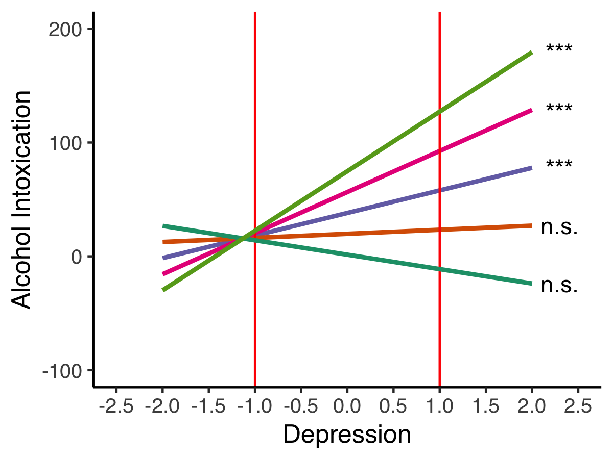
Provide an indication of whether the slope is different from zero.
-Our tables might show this, but our plots should also.
Notes:
If this slope is not significantly different from zero, we would say only that depression is a risk factor for alcohol problems at mean levels of drinking or higher. I.e., no protective effects.
Balance detecting effects that are there with suggesting ones that aren’t.

Slide 24
Does our interpretation change when we probe across more than just two levels?
 | β | Estimate | SE | 95% CI Lower Bound | 95% CI Upper Bound | t value | Pr(>|t|)
 | 0 | 1.456 | 9.54 | -17.399 | 20.31 | 0.153 | 0.879
center(X) | -0.218 | -14.149 | 8.762 | -31.467 | 3.168 | -1.615 | 0.109
probe.2sdlow(Z) | 0.315 | 17.291 | 4.001 | 9.383 | 25.199 | 4.321 | 0
center(X):probe.2sdlow(Z) | 0.263 | 17.113 | 3.668 | 9.863 | 24.362 | 4.665 | 0
 | β | Estimate | SE | 95% CI Lower Bound | 95% CI Upper Bound | t value | Pr(>|t|)
 | 0 | 19.803 | 5.994 | 7.958 | 31.648 | 3.304 | 0.001
center(X) | 0.062 | 4.008 | 5.873 | -7.598 | 15.615 | 0.683 | 0.496
probe.low(Z) | 0.315 | 17.291 | 4.001 | 9.383 | 25.199 | 4.321 | 0
center(X):probe.low(Z) | 0.263 | 17.113 | 3.668 | 9.863 | 24.362 | 4.665 | 0

Slide 25
The benefit with the centering approach in regression is you’ve also conducted simple slopes analysis.
 | β | Estimate | SE | 95% CI Lower Bound | 95% CI Upper Bound | t value | Pr(>|t|)
 | 0 | 74.845 | 9.325 | 56.414 | 93.275 | 8.026 | 0
center(X) | 0.9 | 58.482 | 9.456 | 39.793 | 77.171 | 6.184 | 0
probe.2sdhigh(Z) | 0.315 | 17.291 | 4.001 | 9.383 | 25.199 | 4.321 | 0
center(X):probe.2sdhigh(Z) | 0.263 | 17.113 | 3.668 | 9.863 | 24.362 | 4.665 | 0
 | β | Estimate | SE | 95% CI Lower Bound | 95% CI Upper Bound | t value | Pr(>|t|)
 | 0 | 56.497 | 5.822 | 44.991 | 68.004 | 9.704 | 0
center(X) | 0.62 | 40.324 | 6.388 | 27.699 | 52.95 | 6.312 | 0
probe.high(Z) | 0.315 | 17.291 | 4.001 | 9.383 | 25.199 | 4.321 | 0
center(X):probe.high(Z) | 0.263 | 17.113 | 3.668 | 9.863 | 24.362 | 4.665 | 0

Slide 26
Does our interpretation change when we probe across more than just two levels?
 | β | Estimate | SE | 95% CI Lower Bound | 95% CI Upper Bound | t value | Pr(>|t|)
 | 0 | 1.456 | 9.54 | -17.399 | 20.31 | 0.153 | 0.879
center(X) | -0.218 | -14.149 | 8.762 | -31.467 | 3.168 | -1.615 | 0.109
probe.2sdlow(Z) | 0.315 | 17.291 | 4.001 | 9.383 | 25.199 | 4.321 | 0
center(X):probe.2sdlow(Z) | 0.263 | 17.113 | 3.668 | 9.863 | 24.362 | 4.665 | 0
 | β | Estimate | SE | 95% CI Lower Bound | 95% CI Upper Bound | t value | Pr(>|t|)
 | 0 | 19.803 | 5.994 | 7.958 | 31.648 | 3.304 | 0.001
center(X) | 0.062 | 4.008 | 5.873 | -7.598 | 15.615 | 0.683 | 0.496
probe.low(Z) | 0.315 | 17.291 | 4.001 | 9.383 | 25.199 | 4.321 | 0
center(X):probe.low(Z) | 0.263 | 17.113 | 3.668 | 9.863 | 24.362 | 4.665 | 0

Slide 27
Does our interpretation change when we probe across more than just two levels?
“A-HA! I knew it! We missed something!”
 | β | Estimate | SE | 95% CI Lower Bound | 95% CI Upper Bound | t value | Pr(>|t|)
 | 0 | -5.883 | 11.097 | -27.815 | 16.048 | -0.53 | 0.597
center(X) | -0.329 | -21.413 | 10.108 | -41.39 | -1.435 | -2.118 | 0.036
probe.2.4sdlow(Z) | 0.315 | 17.291 | 4.001 | 9.383 | 25.199 | 4.321 | 0
center(X):probe.2.4sdlow(Z) | 0.263 | 17.113 | 3.668 | 9.863 | 24.362 | 4.665 | 0
 | β | Estimate | SE | 95% CI Lower Bound | 95% CI Upper Bound | t value | Pr(>|t|)
 | 0 | 19.803 | 5.994 | 7.958 | 31.648 | 3.304 | 0.001
center(X) | 0.062 | 4.008 | 5.873 | -7.598 | 15.615 | 0.683 | 0.496
probe.low(Z) | 0.315 | 17.291 | 4.001 | 9.383 | 25.199 | 4.321 | 0
center(X):probe.low(Z) | 0.263 | 17.113 | 3.668 | 9.863 | 24.362 | 4.665 | 0

Slide 28
What would happen if we did this across ALL levels of Z?
This is regions-of-significance analysis (Preacher et al., 2006; Curran & Bauer, 2004)

Slide 29
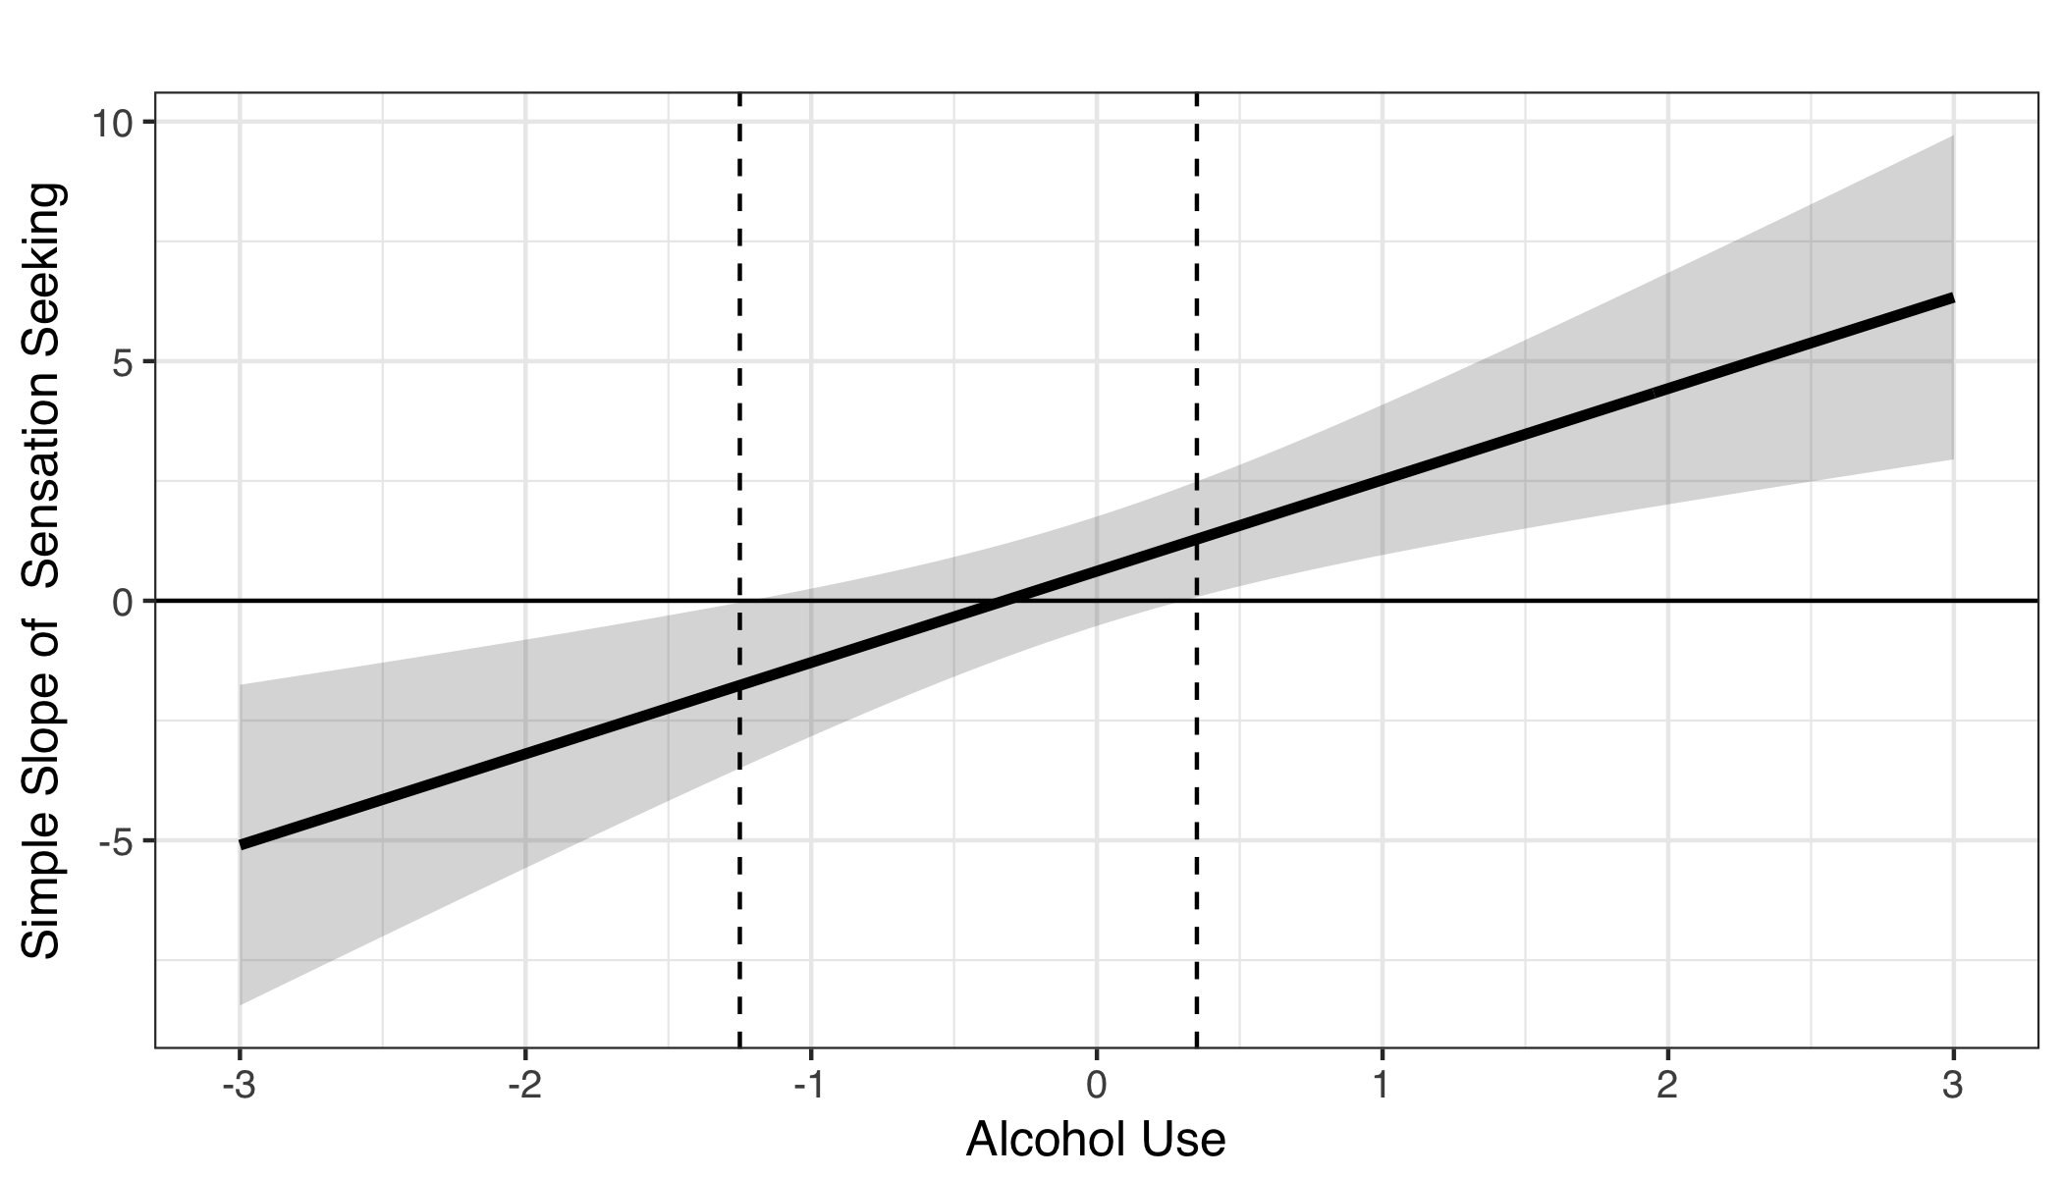
NOTE: this approach can lead to incorrect inferences.
The simple slope of sensation seeking on alcohol problems was significant and negative when alcohol use was -1.25 SDs from the mean or lower. The simple slope was significant and positive when use was 0.35 SDs or higher.
King, Karyadi, Luk, & Poteck-Peckham, 2011
Notes:
I’ve even done my due diligence!
Conducted a regions of significance analysis, confirmed my suspicions about this plot
Specifically, that…

Slide 30
NOTE: this approach can lead to incorrect inferences.
The simple slope of sensation seeking on alcohol problems was significant and negative when alcohol use was -1.25 SDs from the mean or lower. The simple slope was significant and positive when use was 0.35 SDs or higher.
King, Karyadi, Luk, & Poteck-Peckham, 2011
Notes:
I’ve even done my due diligence!
Conducted a regions of significance analysis, confirmed my suspicions about this plot
Specifically, that…

Slide 31
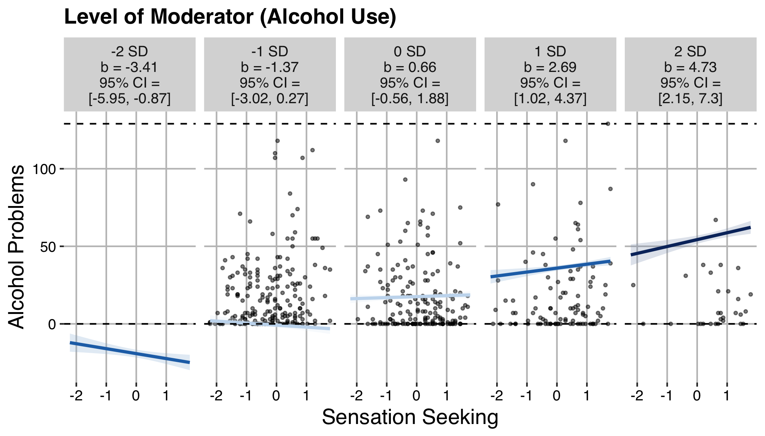
Whoops.
Notes:
no observations at -2 SDs from the mean, even if significant
- -1 SD graph characterizes data poorly
-But, lines (and confidence regions) look reasonable thereafter.
-Reason: use is SKEWED, and traditional +- 1 SD approach not apporpriate.

Slide 32
Extra slides

Slide 33
Adolescent risk behaviors might reflect Heightened Sensation seeking and poor impulse control.
Sensation Seeking
Poor Impulse Control
Disposition toward novelty and excitement
Disposition toward not thinking before acting
Steinberg, 2009; Harden & Tucker-Drobb, 2011
Notes:
-Although the theory behind this framework is neurobiological, we see exactly the same trends in trait measures of these systems as well.

Slide 34
This interaction should also predict Individual Differences in Risk Behavior.
Relative Strength
Age
Steinberg, 2013, 2010; Galvan, 2007; Galavan et al., 2006; Ernst et al., 2005; Gogtay et al., 2004; Giedd, 2004; Casey, Jones, & Hare, 2008
Notes:
-So really, what might explain adolescent risk-taking is an interaction between these two systems, and interaction is known as Laurence Steinberg’s dual systems model of adolescent risk behavior.
-The evidence for Steinberg’s model is as follows…
-Effectively, what this model suggests is that this framework can be tested as an interaction. That is, if this framework is true, we should see this effect that looks something like this. High sensation seeking and poor impulse control should characterize adolescents who exhibit the highest rates of risk behaviors.
-In spite of the popularity of this perspective, there is no evidence that this interaction has been tested in the adolescent literature, so the goal of the present study was primarily to do that.
-I started with a college student sample and I did indeed find evidence of this interaction for problem drinking among young adults, such that high sensation seeking and low impulse control characterized those with more drinking consequences, and I sought to replicate this finding in an adolescent sample.

Slide 35
This interaction should also predict Individual Differences in Risk Behavior.
Relative Strength
Age
Steinberg, 2013, 2010; Galvan, 2007; Galavan et al., 2006; Ernst et al., 2005; Gogtay et al., 2004; Giedd, 2004; Casey, Jones, & Hare, 2008
Notes:
-So really, what might explain adolescent risk-taking is an interaction between these two systems, and interaction is known as Laurence Steinberg’s dual systems model of adolescent risk behavior.
-The evidence for Steinberg’s model is as follows…
-Effectively, what this model suggests is that this framework can be tested as an interaction. That is, if this framework is true, we should see this effect that looks something like this. High sensation seeking and poor impulse control should characterize adolescents who exhibit the highest rates of risk behaviors.
-In spite of the popularity of this perspective, there is no evidence that this interaction has been tested in the adolescent literature, so the goal of the present study was primarily to do that.
-I started with a college student sample and I did indeed find evidence of this interaction for problem drinking among young adults, such that high sensation seeking and low impulse control characterized those with more drinking consequences, and I sought to replicate this finding in an adolescent sample.

Slide 36
This interaction should also predict Individual Differences in Risk Behavior.
More Risk
Less Risk
Relative Strength
Age
Steinberg, 2013, 2010; Galvan, 2007; Galavan et al., 2006; Ernst et al., 2005; Gogtay et al., 2004; Giedd, 2004; Casey, Jones, & Hare, 2008
Notes:
-So really, what might explain adolescent risk-taking is an interaction between these two systems, and interaction is known as Laurence Steinberg’s dual systems model of adolescent risk behavior.
-The evidence for Steinberg’s model is as follows…
-Effectively, what this model suggests is that this framework can be tested as an interaction. That is, if this framework is true, we should see this effect that looks something like this. High sensation seeking and poor impulse control should characterize adolescents who exhibit the highest rates of risk behaviors.
-In spite of the popularity of this perspective, there is no evidence that this interaction has been tested in the adolescent literature, so the goal of the present study was primarily to do that.
-I started with a college student sample and I did indeed find evidence of this interaction for problem drinking among young adults, such that high sensation seeking and low impulse control characterized those with more drinking consequences, and I sought to replicate this finding in an adolescent sample.

Slide 37
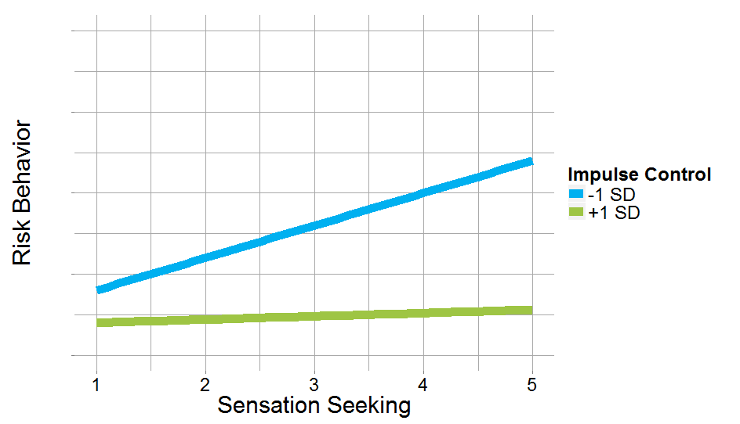
This interaction should also predict Individual Differences in Risk Behavior.
Notes:
-So really, what might explain adolescent risk-taking is an interaction between these two systems, and interaction is known as Laurence Steinberg’s dual systems model of adolescent risk behavior.
-The evidence for Steinberg’s model is as follows…
-Effectively, what this model suggests is that this framework can be tested as an interaction. That is, if this framework is true, we should see this effect that looks something like this. High sensation seeking and poor impulse control should characterize adolescents who exhibit the highest rates of risk behaviors.
-In spite of the popularity of this perspective, there is no evidence that this interaction has been tested in the adolescent literature, so the goal of the present study was primarily to do that.
-I started with a college student sample and I did indeed find evidence of this interaction for problem drinking among young adults, such that high sensation seeking and low impulse control characterized those with more drinking consequences, and I sought to replicate this finding in an adolescent sample.

